Slide 1
MEASUREMENT OF PHYSICAL AND CHEMICAL WATER QUALITY PARAMETERS
M.G.CYRIAC

Slide 2
Pollution of water sources
With the increase in population and development in all spheres of life water sources gets polluted
Pollution effects are manifeted as physical al and organoleptic , chemical and microbiological water quality parameters

Slide 3

Pollution of water sources and its bad effects
Physical and organoleptic -that can be detected by the sense organs-taste,odour,colour etc
Chemical-presence of chemical constituents,-Acidity, Alkalinity,Iron, Flouride,Arsenic
Microbiological-Presence of harmful Bacteria, Virus,Protozoa

Slide 4
Water quality Parameters
Physical and organoleptic
Chemical
microbiological

Slide 5
Physical Water Quality
Parameters
Taste and odour
Turbidity
Colour
pH value
Conductivity
Total dissolved solids

Slide 6
Chemical water quality parameters
Acidity
Alkalinity
Hardness
Iron
Flouride
Chloride
Arsenic

Slide 7
Microbiological water quality
Bacetria
Virus
Protozoa

Slide 8
Water quality standards
history
In 1931 Churchill ,chemist in the American Aluminum company noted enameled teeth among the people of city of Bauxite in USA
Churchil along with Mcay , a dental doctor carried out detailed study and established that the root cause is presence of Flouride in drinking water

Slide 9
They also established that the maximum limit of Fluoride in drinking water is 1.5 mg/ litre which is still followed

Slide 10
History of water borne diseases
14th Century - Black Death in Europe-
Killed 14% people of Europe
1769 -Repeated the same problem
and killed 25% of the people of Europe
1854 -Spread of Asiatic Cholera in London town- Found out the root cause of the problem-John snow &John York

Slide 11
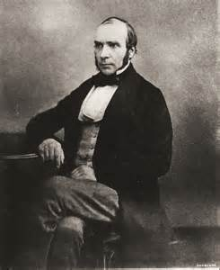
John snow
He is considered one of the fathers of modern epidemiology, in part because of his work in tracing the source of a cholera outbreak in Soho, London, in 1854. His findings inspired fundamental changes in the water and waste systems of London, and subsequently in other areas

Slide 12
Measuring Scale and Standards
When the limit of a measuring scale is prescribed it is a standard
BIS
CPHEEO
ICMR
WHO
USEPA

Slide 13
Water Quality Standards
Sl No | Characteristics | Acceptable Limit | Permissible Limit
1 | Colour, Hazen units ,Max | 5 | 15
2 | odour | Agreeable | Agreeable
3 | pH value | 6.5-8.5 | No relaxation
4 | Taste | Agreeable | Agreeable
5 | Turbidity,NTU,Max | 1 | 5
6 | Total dissolved solids,mg/l,Max | 500 | 2000

Slide 14
4 | Barium (as Ba),mg/l,Max | 0.7 | No relaxation
5 | Boron (as B),mg/l,Max | 0.5 | 1.0
6 | Calcium(as Ca),mg/l,Max | 75 | 200
7 | Chloramines (as Cl2),mg/l,Max | 4.0 | No relaxation
8 | Chloride(as Cl),mg/l,Max | 250 | 1 000
9 | Copper (as Cu),mg/l,Max | 0.05 | 1.5
10 | Fluoride(as F),mg/l,Max | 1.0 | 1.5
11 | Free residual chlorine,mg/l,Min | 0.2 | 1
12 | Iron (as Fe),mg/l,Max | 0.3 | No relaxation
13 | Magnesium (as Mg),mg/l,Max | 30 | 100
14 | Manganese (as Mn),mg/l,Max | 0.1 | 0.3
15 | Mineral oil,mg/l,Max | 0.5 | No relaxation
16 | Nitrate (as NO3),mg/l,Max | 45 | No relaxation
17 | Phenolic compounds (as C6H5OH),mg/l,Max | 0.001 | 0.002

Slide 15
18 | Selenium (as Se),mg/l,Max | 0.01 | No relaxation
19 | Silver (as Ag),mg/l,Max | 0.1 | No relaxation
20 | Sulphate (as SO4),mg/l,Max | 200 | 400
21 | Sulphide (as H2S),mg/l,Max | 0.05 | No relaxation
22 | Total alkalinity as calcium carbonate,mg/l,Max | 200 | 600
23 | Total hardness (as CaCO3),mg/l,Max | 200 | 600
24 | Zinc (as Zn),mg/l,Max | 5 | 15

Slide 16
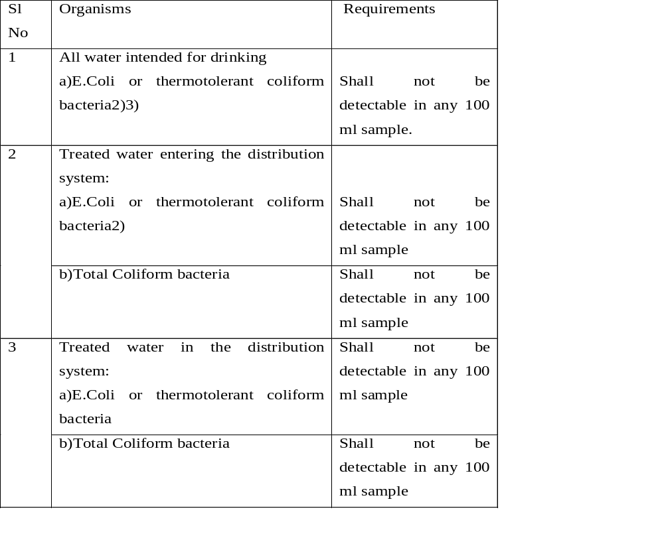

Slide 17
Turbidity
Unit-NTU
Nephelo Turbidity Unit
1mg silica dissolved in 1litre of distilled water
1NTU of turbidity
Measured by using turbidity meter

Slide 18
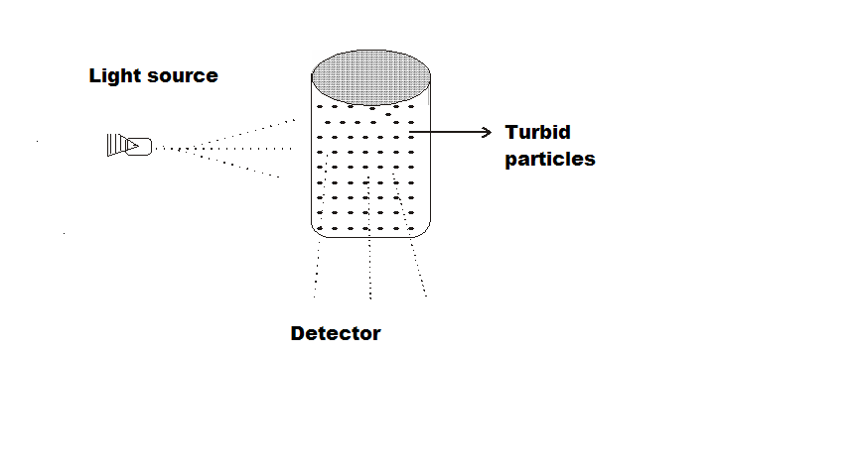
Turbidity Meter

Slide 19
Colour
1mg platinum cobalt dissolved in 1litre of distilled water gives 1unit of colour in cobalt scale
Colour comparison tubes are prepared

Slide 20
pH value- Potenso hydrogen
H₂O--- H⁺+OH⁻ ( theory of Ionization)
H⁺ ion is having a significant effect on the
quality of water
pH Concept was introduced by Sorenson in 1909
He was a chemist in the Calsberg laboratory in Denmark
Measured by using pH meter

Slide 21
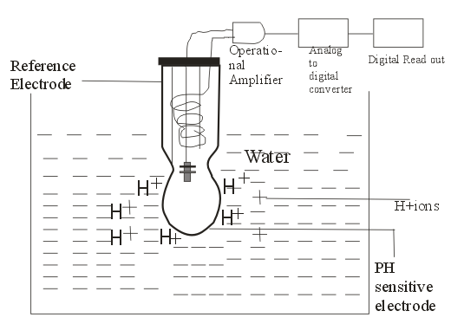

Slide 22
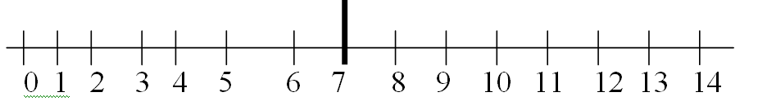
Alkaline Range
Acidic range
pH Scale

Slide 23
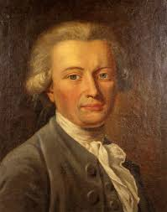
Henry Cavendish-discovered hydrogen

Slide 24
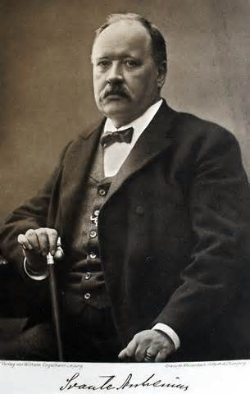
Svante Arrhenius(1859-1927) was a Swedish physicist and physical chemist who formulated the theory of electrolytic dissociation.

Slide 25
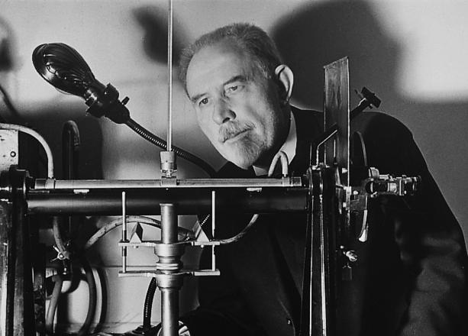
SPL SORENSON(1868 – 1939) Denmark , famous for the introduction of pH concept

Slide 26
Conductivity
Ability of the water to conduct electricity
Unit-micromhos/cm
Proportional to the quantity of dissolved solids in the water
Measured by using conductivity meter

Slide 27
Total dissolved solids
Measured by evaporating to dryness water in a porcelain dish and thereafter finding out the weight of the residue
TDS is proportional to conductivity
Approximately =2/3 micromhos /cm of condutivity

Slide 28
Volumetric Analysis
Reaction between two mutually reactive chemicals
A chemical of known strength is used which is termed as reagent
End point is denoted by colour change using an indicator
Indicator reacts with the excess chemical added and thus the colour is formed

Slide 29
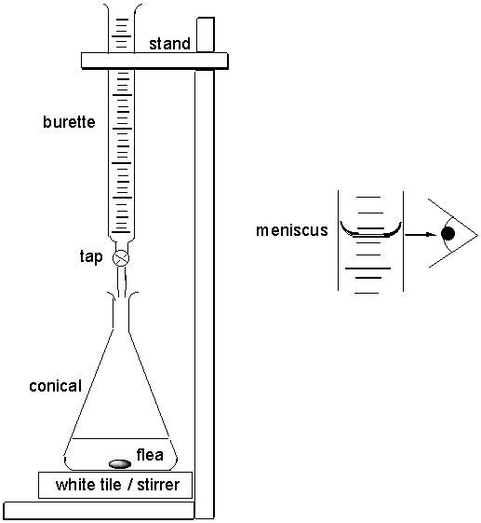
Arrangement for volumetric analysis

Slide 30
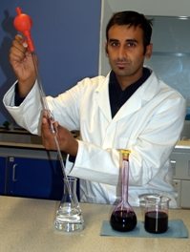

Slide 31
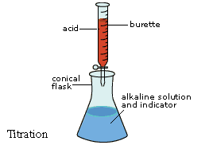

Slide 32
calculation
V1 N1= V2N2
V1=50ml N1=.025 V2= 36ml
Find the value of N2

Slide 33
SL NO | Chemical to be evaluated | Reagent | Indicator | End point colour
1 2 3 4 | Acidity Alkalinity Hardness Chloride | Sodium Hydroxide Sulfuric acid EDTA Silver Nitrate | Phenolphtha- Lein Methyl orange Erichrome Black T Pottasium Chromate | Pink Orange Blue Red deposit

Slide 34
Colorimetry
Formation of colour due to the reaction of a
Chemical in the water with a predetermined chemical in the prescribed mode
Formation of colour takes place
Intensity of the colour is proportional to the quantity of chemical present in the water
Simple method commonly used is the measurement of residual Chlorine

Slide 35
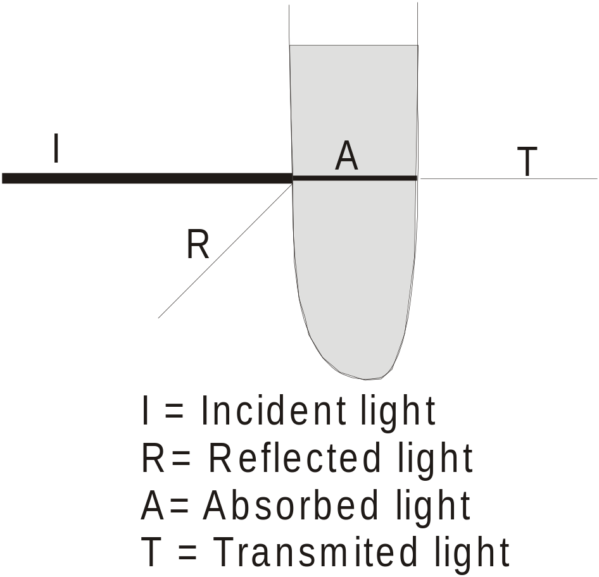
Colorimeter and spectrophotometer

Slide 36
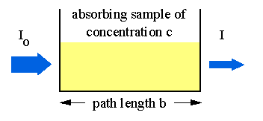
Lamberts law
According to Lamberts law, when monochromatic light pass through a medium, the intensity of transmitted light is inversely proportional to the thickness of the medium.

Slide 37
Mathematical Expression of Lamberts law
That is, T=I/I0=10^{-a1e}
Where, T=Transmittance
I0= The intensity of light entering the medium
I = The intensity of transmitted light
a 1 = Constant of the medium
e = The thickness of the medium absorbing the light

Slide 38
Beers law
According to this rule, the intensity of a beam of light passing through a medium which absorb light, is inversely proportional to the colour intensity of that medium.
That is, T= I/IO = 10 ^{–a2C}
Where, a2 = the constant of a particular medium.
C= The colour concentration of the medium

Slide 39
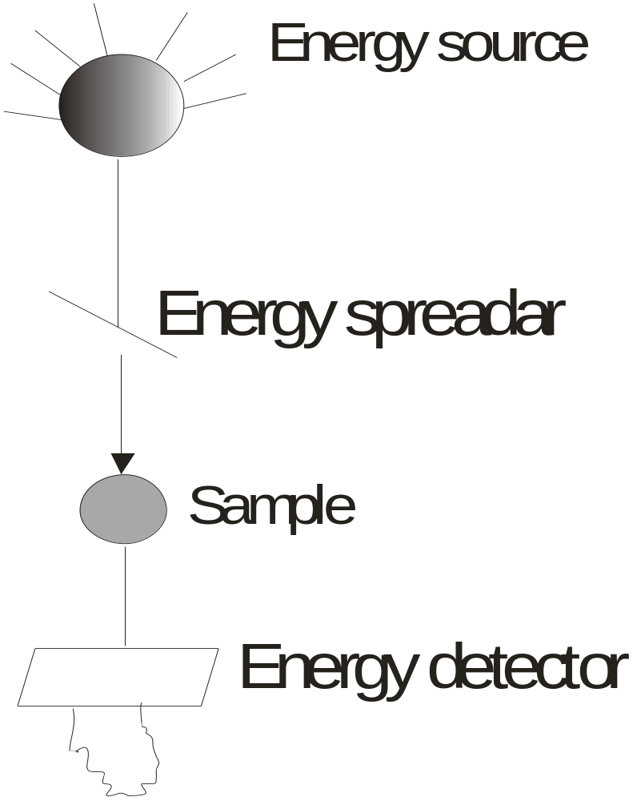

Slide 40
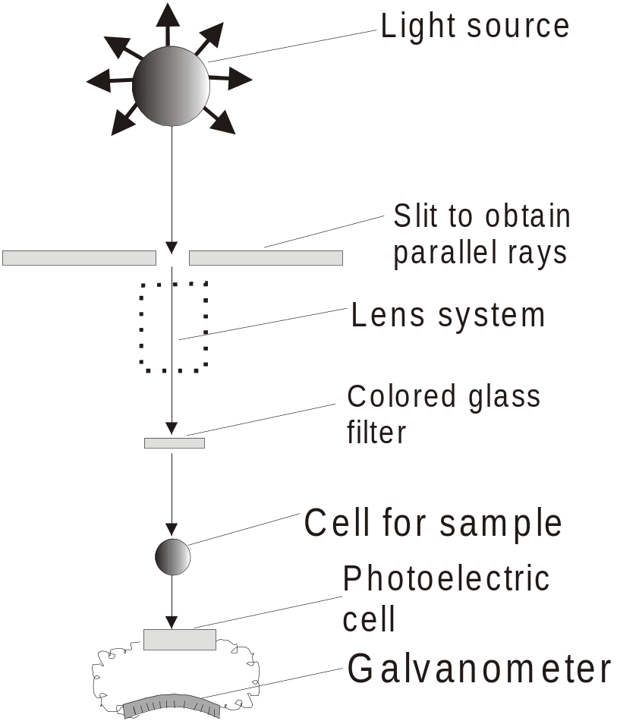
Colorimeter

Slide 41
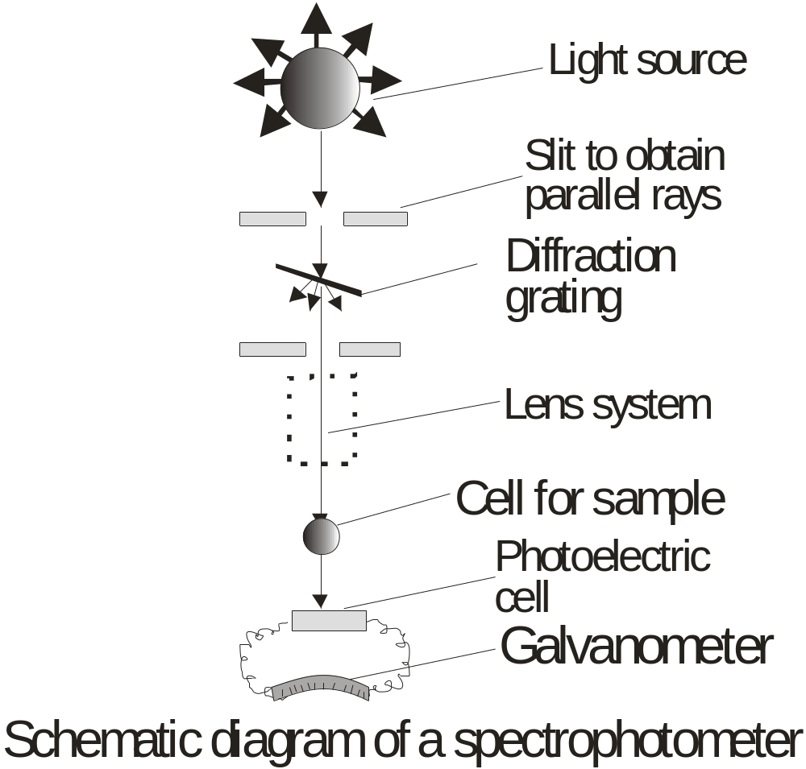

Slide 42
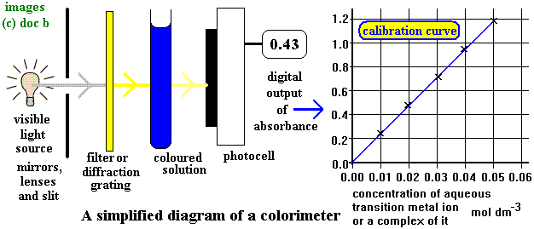
Calibration of colorimetric instrument

Slide 43
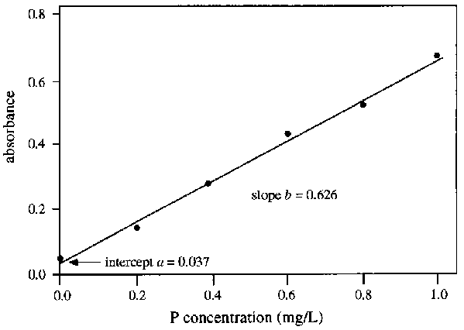
Calibartion graph

Slide 44
Sl NO | Chemical to be estimated | Chemical to be added | colour | Wave length
1 2 3 | Iron Flouride Nitrate | 1.10 phenanthraline Ammonium acetate And spands reagent Hcl | Light brown Reduction in colour upon increase in Flouride Not detected by Naked eye | 510 570 220& 275

Slide 45
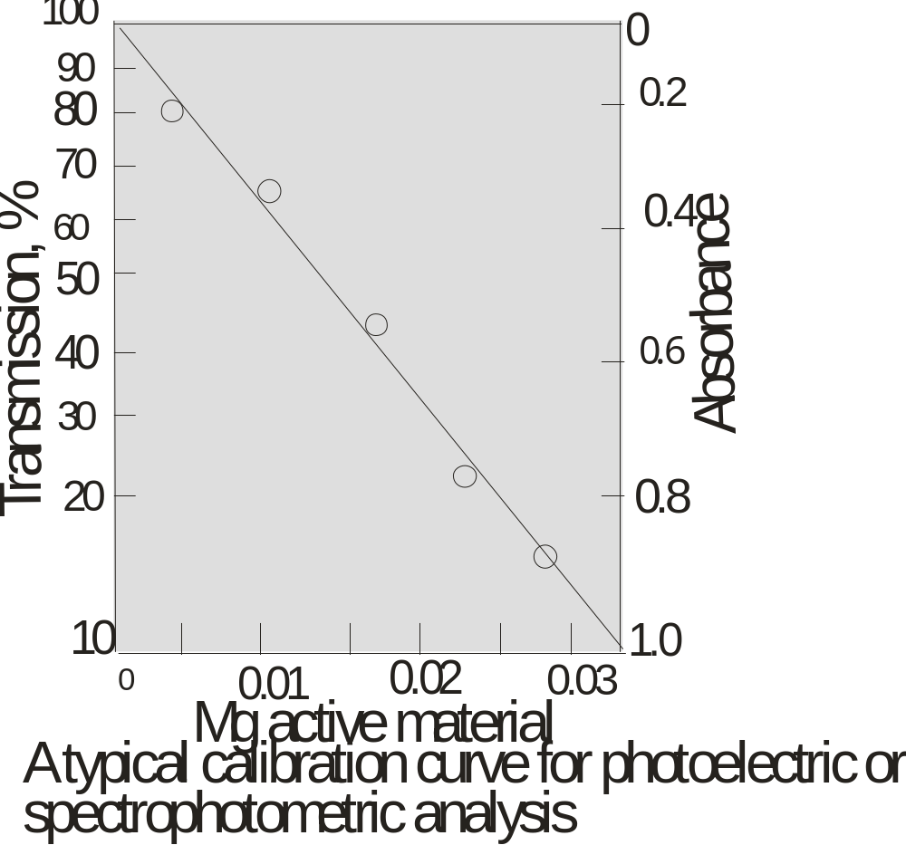

Slide 46
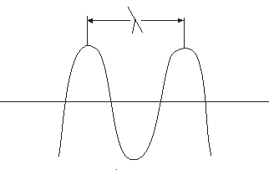
Wavelength of light and importance in colorimetery

Slide 47
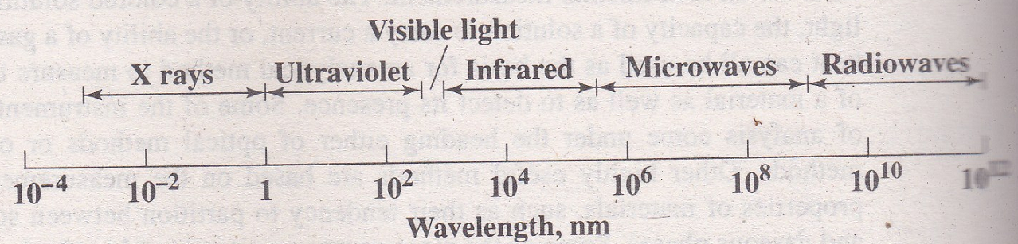
Wave length of different waves

Slide 48
When light ray passes through coloured liquid, the ability to absorb light differ according to the wavelength.
The wave length at which the maximum light is absorbed is used for examination of samples
When colorimetric instruments are used there is a specific wavelength for measurement of each parameter ie 510nm for Iron

Slide 49
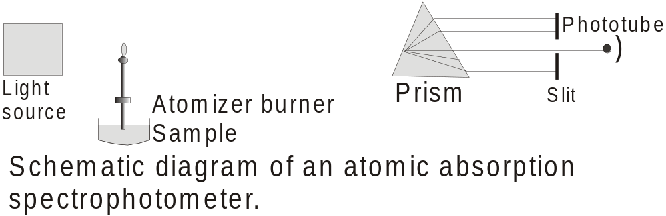

Slide 50
Tests to identify organic pollution
Biochemical Oxygen Demand (BOD)
Chemical Oxygen Demand (COD)

Slide 51
Biochemical oxygen demand
BOD is the quantity of oxygen required to convert the organic matter in the water , to carbon dioxide and water by oxidation. When BOD increases, it means increase in water pollution level. To calculate BOD, the dissolved oxygen is water is first assessed. Next the sample is kept at 20^{0c} in a BOD incubator for 5 days and the DO is again determined. The difference will give oxygen required during the period

Slide 52
Chemical Oxygen Demand
COD is the quantity of oxygen required to oxidize the organic matter in water using chemical compounds.

Slide 53
Turbidimetry
Turbidimetry is another method for analysis of water quality parameter . In which turbidity is formed by reaction of a pre-determined chemical with the mineral to be measured
The method is based on the concept that the turbidity formed is proportional to the quantity of chemical present

Slide 54
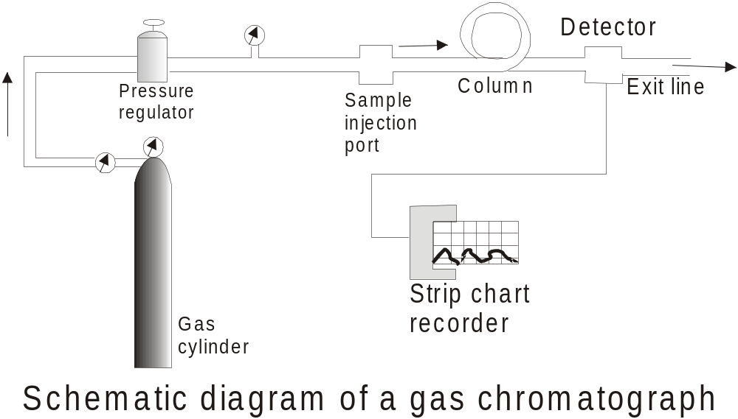

Slide 55
